Slide 1
Piece of Eden rentals
CMSC 447: TEAM 3

Slide 2
THE TEAM
Rachel Cohen: Team Facilitator
Matt Walker: Requirements Leader
Eric Forte: Design Leader
Nick Keckeisen: Implementation & Testing Leader
Stephen Masterson: Delivery Leader

Slide 3
The Assignment
Create a sharing economy system capable of supporting access to goods/services
Minimum Specifications
Create accounts
Share good/service
Receive good/service
Search feature
Provide admin users
Provide user profiles
Ensure Security

Slide 4
Our web application
A rental service for beachfront vacation properties
Renters → find properties for vacation
Home owners → list your beachfront property for added income
Main Functions
Create a user profile
Upload a property
Search for and view a property
Rent the property
View a property on Google Maps interface

Slide 5
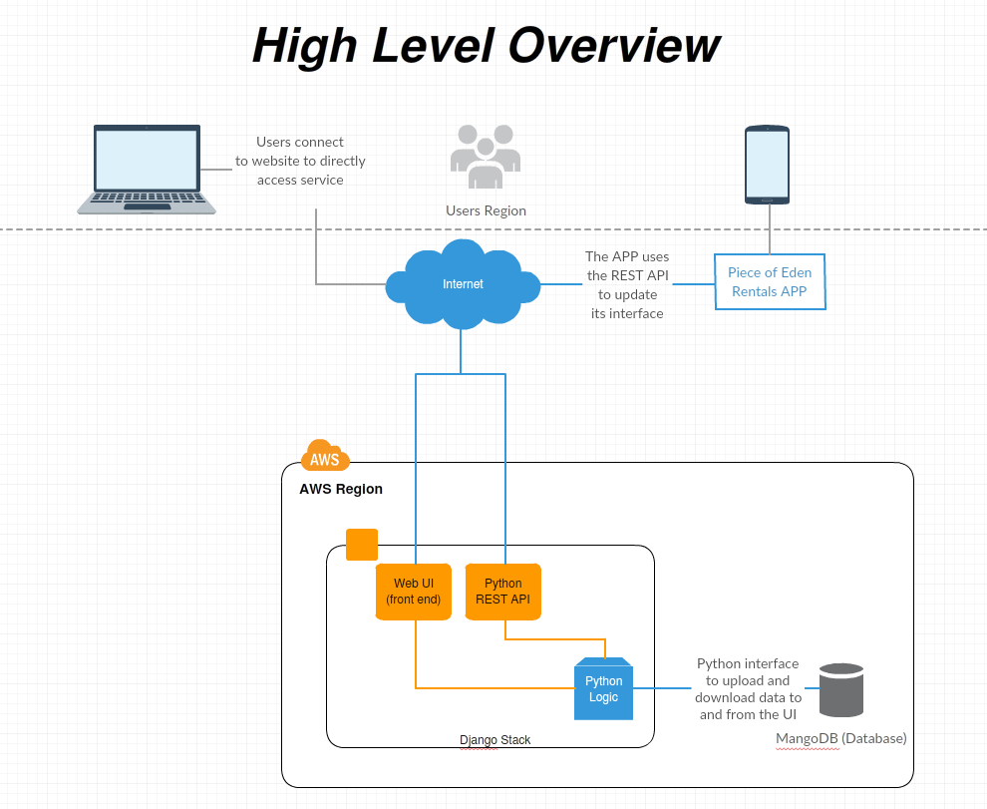

Slide 6
Design technologies
Amazon Web Services for easy and reliable website hosting
Django web framework using Python for a clean & pragmatic design
Python REST API
MangoDB for data storage & retrieval

Slide 7
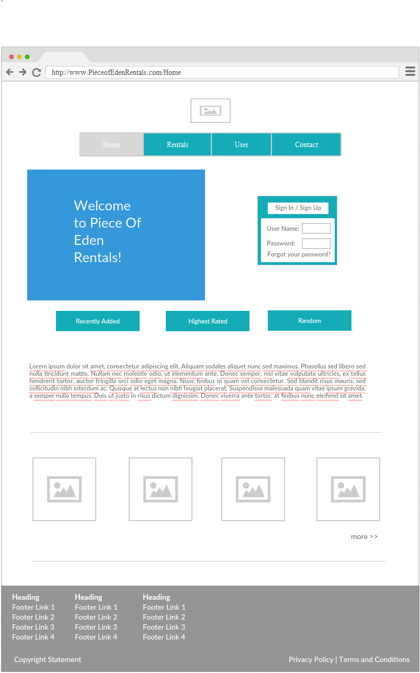
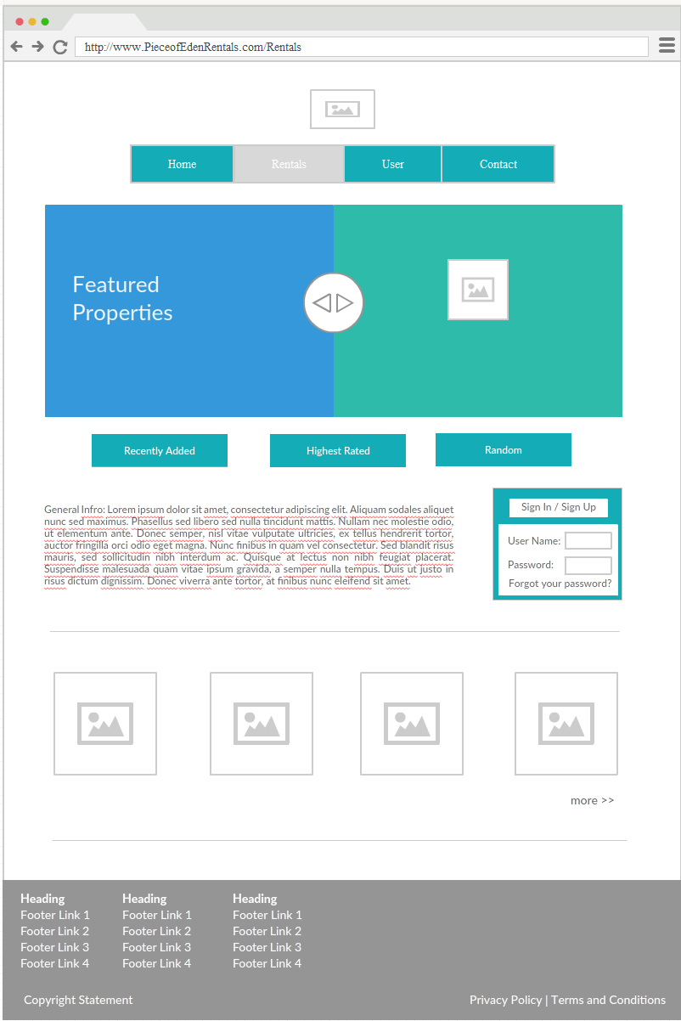
Home & Rental pages

Slide 8
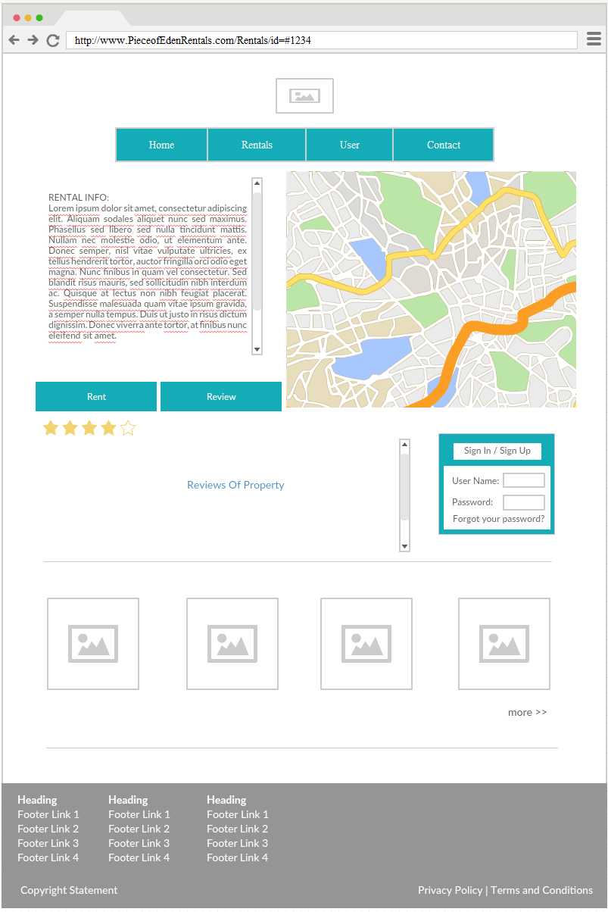
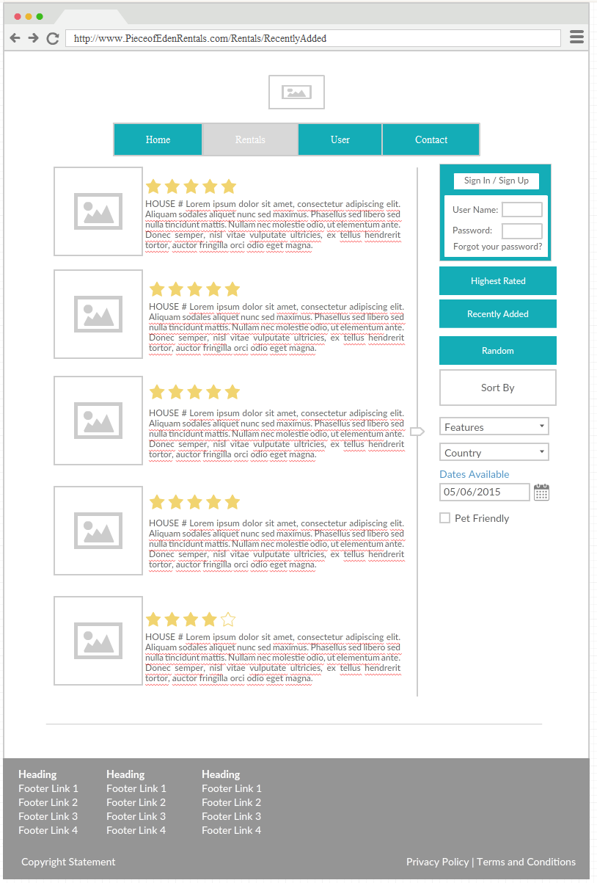
Search & Maps pages

Slide 9
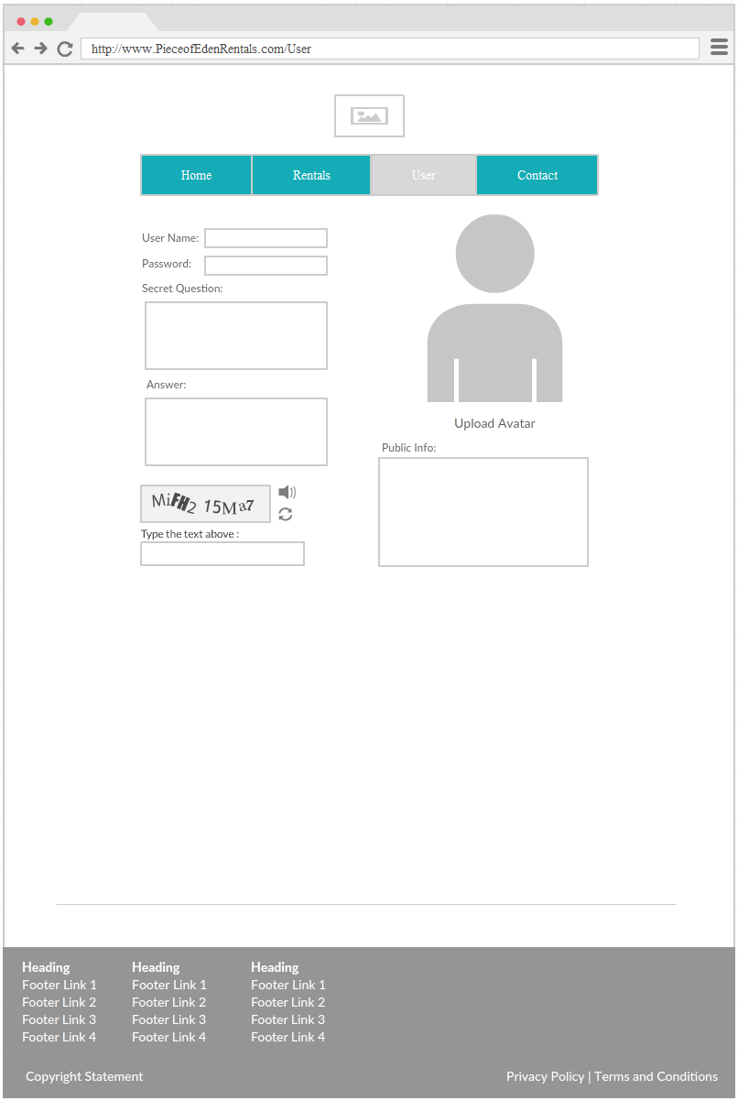
User Page

